Slide 1
TOURIST GUIDE MANAGEMENT SYSTEM

Slide 2
ABSTRACT
Tourism Management System is a complete tourist fully integrated tourism web site. The website covers all the areas required for an including tourism. This project is developed to manage the tourist in the tourism management web site. The main module in this project are login, tourist management, complaints and reports.
The objective of the project is to develop a system that automates the processes and activities of a travel and. The purpose is to design a system using which one can perform all operations related to traveling.

Slide 3
Hardware Specification
Processor : P 4 700 GHz.
RAM : 256MB RAM
Hard Disk Drive : 40 GB HDD

Slide 4
Software Specification
Operating System : Windows XP/7/8/10
Front End : JAVA
Back End : MY SQL

Slide 5
EXISTING SYSTEM
In the present system a customer has to approach various agencies to find details of places and book tickets. this often requires a lot of time and effort. A customer may not get desired information from these offices and often the customer may be misguided. It is tedious for a customer to plan a particular journey and have it executed properly.

Slide 6
Disadvantages:
This system is not an user friendly.
Can’t use all users

Slide 7
PROPOSED SYSTEM
The proposed system is a web-based application and maintains centralized repository of all related information. The system allows one to easily access the relevant information and make necessary arrangements. User can decide about places they want to visit and make bookings online for travel and accommodation

Slide 8
Advantages:
User no need to google it.
Save time
Amazing web site design

Slide 9
MODULES
Create User Account
Create & Manage Tour Package
Booking Places
Manage Booking
Manage Enquiries

Slide 10
Create User Account
User can manually open this application and create the account, once the account has been created then user can able to login by using username and password. After the login only user can select the package and booking their favorite places.
Create & Managing Tour Package
Admin can create and modify the package details, this screen has to collect some information for package name, package type, location, price, images etc. This packages are displaying in the user account and they can book the package.

Slide 11
Book Places
The package details are displaying in the user portal then the user can check the package details then they can check and book the places. Once the packages are booked then admin will get notify.
Manage Booking
Once the packages are booked then the admin will get notify and view the booking details. The details have user details as well then, they can contact them through mobile. It s an main module for admin can contact them.
Managing Enquiries
If the user wants to collect the enquiries, they have to submit the enquiry details, it will be shown in the admin portal. If the admin wants to clarify their enquiry, they will contact them.

Slide 12

Data Flow Diagram
Level 0

Slide 13
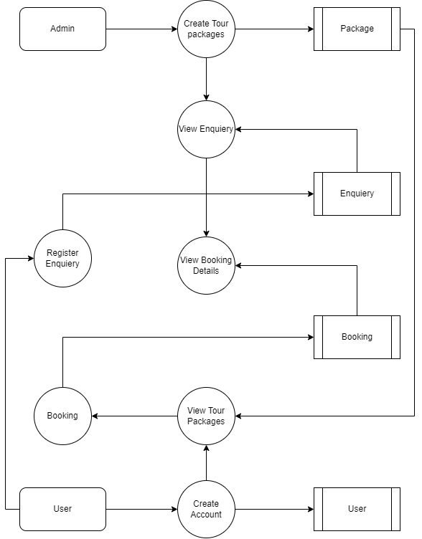
LEVEL 1:

Slide 14
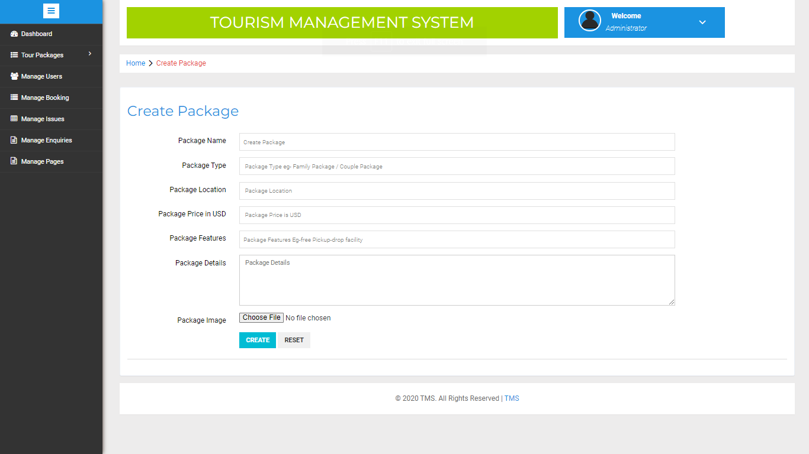

Slide 15
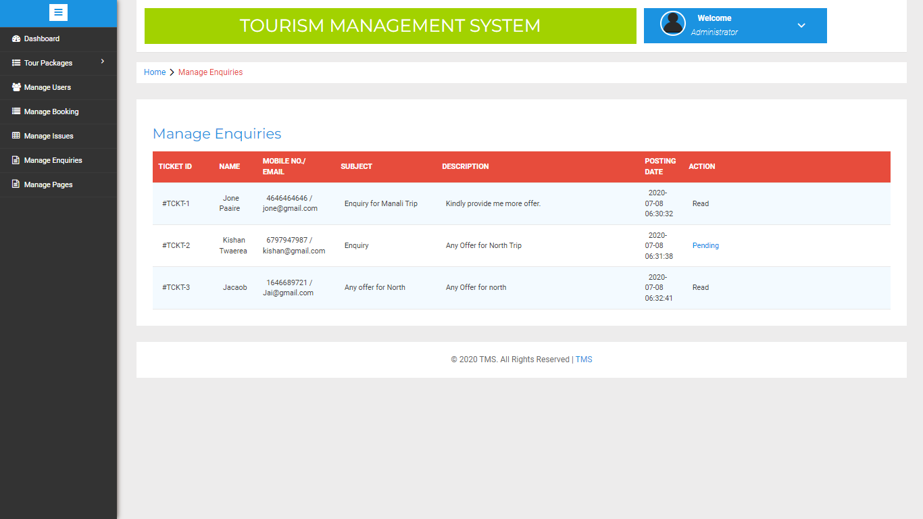

Slide 16
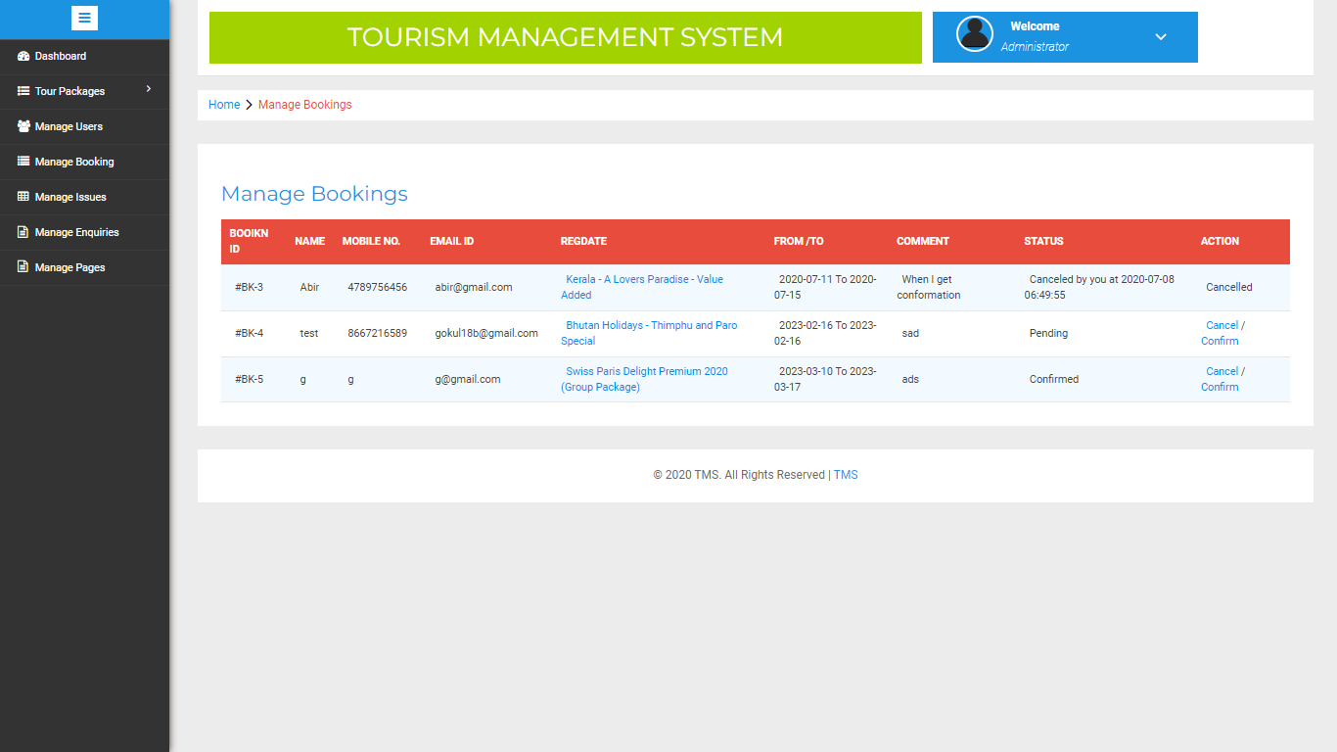

Slide 17
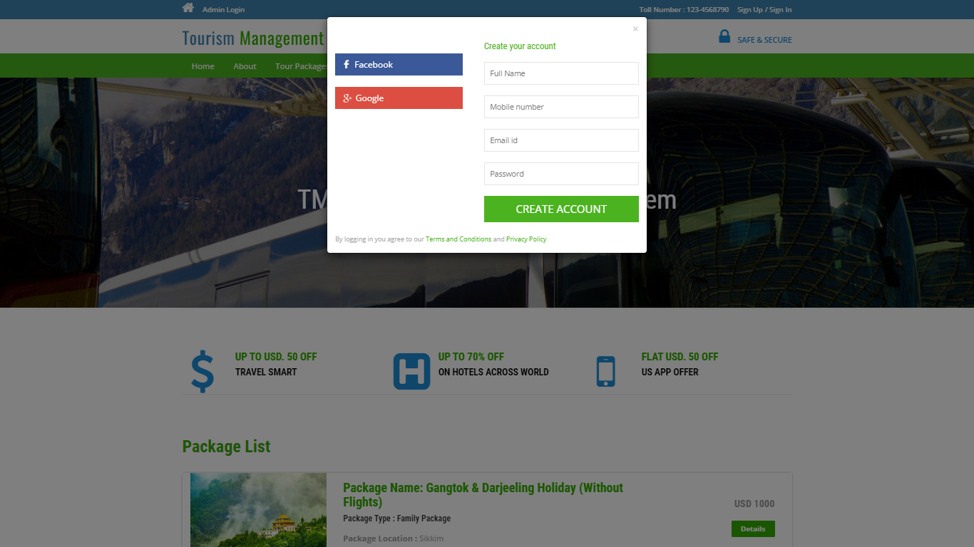

Slide 18
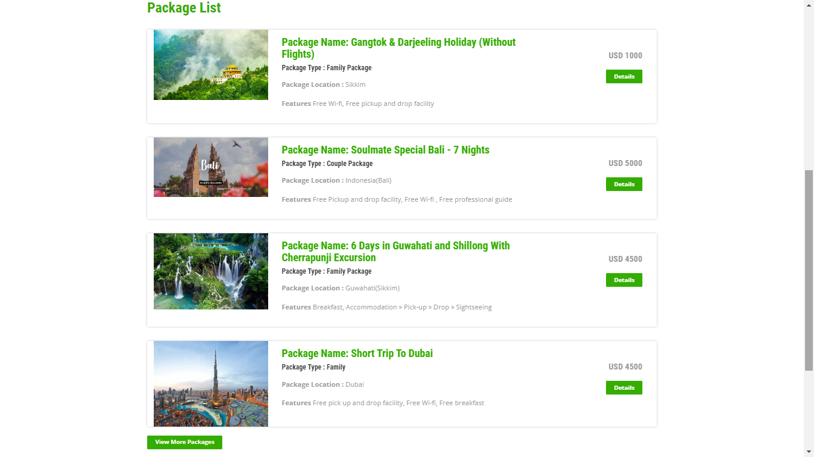

Slide 19
Thank you.....

